Slide 1
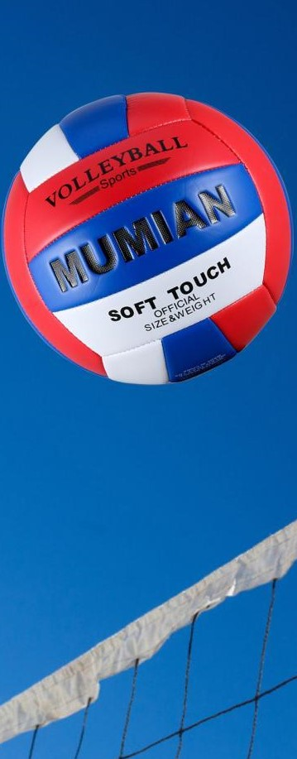
Westside High School
Week At a Glance (WAG)

Slide 2
Coach Thomas
Rec. Games: Sept. 5th- 9th

Slide 3
Monday - Agenda
Learning Target
Sept 5th
Standard:
N/A
Opening ( 10-15 mins)
Work-session ( 20 - 25 mins)
Criteria for Success
Closing ( 05 – 10 mins)

Slide 4
Tuesday - Agenda
Sept 6
Standard:
PERG.1 The physically educated student demonstrates competency in a variety of motor skills and movement patterns.
a. Demonstrates competence while performing skills in a variety of recreational game settings and activities
b. Performs skills at a level of competence, which contributes to health-related fitness.
c. Demonstrates proper warm-up and cool-down protocol associated with different life time
sport physical activities.
PERG.3 The physically educated student demonstrates knowledge and skills to help achieve
and maintain a health-enhancing level of physical activity and fitness.
a. Maintains or improves fitness level by using the results of the Georgia Fitness Assessment
to guide changes in a personal program of physical activity.
b. Uses technologies to assess, enhance, and maintain health-related and skill-related fitness.
c. Analyzes the relationship between physical activity and longevity.
Personal and Social Behavior, Rules, Safety, and Etiquette
Learning Target
I can describe in my own words how to do the following using a volleyball: bump, set, serve (underhand and overhand)
Opening ( 10-15 mins)
N/A
Work-session ( 20 - 25 mins)
Instructions: In class, you we discussed and demonstrated how to perform various volleyball skills including: bumping, setting, hitting, and serving. In your own words provide at least three things that you need to do with your body specific body parts in order to perform each skill. Your paper/text should be done as shown below
Name:
Date:
Description of Volleyball Skills 4.Overhand serve
Step 1
Bump Step 2
Step 1 Step 3
Step 2
Step 3
2. Set
Step 1
Step 2
Step 3
3. Underhand Serve
Step 1
Step 2
Step 3
Criteria for Success
Students are able to describe the technique used to perform the following volleyball skills: bump, set, serve based on class discussion and practice.
Closing ( 05 – 10 mins)

Slide 5
Wednesday - Agenda
Sept 7
Standard:
PERG.1 The physically educated student demonstrates competency in a variety of motor skills and movement patterns.
a. Demonstrates competence while performing skills in a variety of recreational game settings and activities
b. Performs skills at a level of competence, which contributes to health-related fitness.
c. Demonstrates proper warm-up and cool-down protocol associated with different life time
sport physical activities.
PERG.3 The physically educated student demonstrates knowledge and skills to help achieve
and maintain a health-enhancing level of physical activity and fitness.
a. Maintains or improves fitness level by using the results of the Georgia Fitness Assessment
to guide changes in a personal program of physical activity.
b. Uses technologies to assess, enhance, and maintain health-related and skill-related fitness.
c. Analyzes the relationship between physical activity and longevity.
Personal and Social Behavior, Rules, Safety, and Etiquette
Learning Target
Students will be able to play a game of Wiffle ball by following the rules
Opening ( 10-15 mins)
10 minute Walk & Attendance
Work-session ( 20 - 25 mins)
Teacher will explain the rules of wiffle ball
Locker rooms unlocked Students use knowledge from previous day to participate in game of wiffle ball
Students that want to play basketball can do so after 2 games of the previously mentioned
Criteria for Success
Students will participate in games wiffle ball
Closing ( 05 – 10 mins)
-locker room unlocked for 5 minutes
-students use remaining time to cool down & rehydrate if necessary

Slide 6
Thursday - Agenda
^{Sept} 8
Standard:
PERG.1 The physically educated student demonstrates competency in a variety of motor skills and movement patterns.
a. Demonstrates competence while performing skills in a variety of recreational game settings and activities
b. Performs skills at a level of competence, which contributes to health-related fitness.
c. Demonstrates proper warm-up and cool-down protocol associated with different life time
sport physical activities.
PERG.3 The physically educated student demonstrates knowledge and skills to help achieve
and maintain a health-enhancing level of physical activity and fitness.
a. Maintains or improves fitness level by using the results of the Georgia Fitness Assessment
to guide changes in a personal program of physical activity.
b. Uses technologies to assess, enhance, and maintain health-related and skill-related fitness.
c. Analyzes the relationship between physical activity and longevity.
Personal and Social Behavior, Rules, Safety, and Etiquette
Learning Target
I can demonstrate my mastery of this week’s learning targets
Opening ( 10-15 mins)
5 minute Walk & Attendance
Work-session ( 20 - 25 mins)
Same as previous day
Criteria for Success
Same as previous day
Closing ( 05 – 10 mins)
-locker room unlocked for 5 minutes
-students use remaining time to cool down & rehydrate if necessary

Slide 7
Friday - Agenda
Sept 9th
Standard:
PERG.1 The physically educated student demonstrates competency in a variety of motor skills and movement patterns.
a. Demonstrates competence while performing skills in a variety of recreational game settings and activities
b. Performs skills at a level of competence, which contributes to health-related fitness.
c. Demonstrates proper warm-up and cool-down protocol associated with different life time
sport physical activities.
PERG.3 The physically educated student demonstrates knowledge and skills to help achieve
and maintain a health-enhancing level of physical activity and fitness.
a. Maintains or improves fitness level by using the results of the Georgia Fitness Assessment
to guide changes in a personal program of physical activity.
b. Uses technologies to assess, enhance, and maintain health-related and skill-related fitness.
c. Analyzes the relationship between physical activity and longevity.
Personal and Social Behavior, Rules, Safety, and Etiquette
Learning Target
Freestyle Friday
Opening ( 10-15 mins)
Attendance
Work-session ( 20 - 25 mins)
Students are able to engage in various activities/sports typically those that they are most interested
Teacher will conference will students and possibly make parent phone calls/contact as needed
Criteria for Success
I can demonstrate my understanding of the rules, procedures, and expectations by following them during class time and asking questions to teacher if necessary.
Closing ( 05 – 10 mins)
N/A

Slide 8
Resources
https://www.nike.com/nrc-app

